Slide 1
COMP9024: Data Structures and Algorithms
Week Eleven: Graphs (I)
Hui Wu
Session 2, 2015
http://www.cse.unsw.edu.au/~cs9024

Slide 2
Outline
Undirected Graphs and Directed Graphs
Depth-First Search
Breadth-First Search
Transitive Closure
Topological Sorting

Slide 3
Graphs
1843
ORD
SFO
802
337
1743
LAX
1233
DFW

Slide 4
Graphs
A graph is a pair (V, E), where
  V is a set of nodes, called vertices
  E is a collection of pairs of vertices, called edges
  Vertices and edges are positions and store elements
Example:
  A vertex represents an airport and stores the three-letter airport code
  An edge represents a flight route between two airports and stores the mileage of the route
849
PVD
1843
ORD
142
SFO
802
LGA
337
1743
1387
HNL
2555
1099
LAX
1233
DFW
1120
MIA

Slide 5
Edge Types
Directed edge
  ordered pair of vertices (u,v)
  first vertex u is the origin
  second vertex v is the destination
  e.g., a flight
Undirected edge
  unordered pair of vertices (u,v)
  e.g., a flight route
Directed graph
  all the edges are directed
  e.g., route network
Undirected graph
  all the edges are undirected
  e.g., flight network
flight
AA 1206
ORD
PVD
849
miles
ORD
PVD

Slide 6
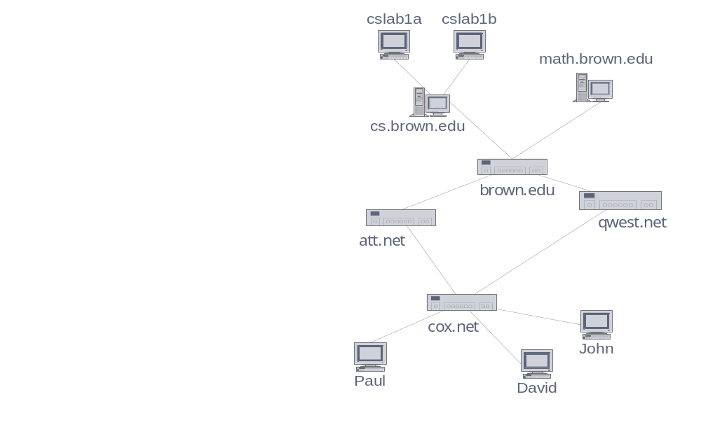
Applications
Electronic circuits
  Printed circuit board
  Integrated circuit
Transportation networks
  Highway network
  Flight network
Computer networks
  Local area network
  Internet
  Web
Databases
  Entity-relationship diagram

Slide 7
Terminology (1/3)
End vertices (or endpoints) of an edge
  U and V are the endpoints of a
Edges incident on a vertex
  a, d, and b are incident on V
Adjacent vertices
  U and V are adjacent
Degree of a vertex
  X has degree 5
Parallel edges
  h and i are parallel edges
Self-loop
  j is a self-loop
V
a
b
h
j
U
d
X
Z
c
e
i
W
g
f
Y

Slide 8
Terminology (2/3)
Path
  sequence of alternating vertices and edges
  begins with a vertex
  ends with a vertex
  each edge is preceded and followed by its endpoints
Simple path
  path such that all its vertices and edges are distinct
Examples
  P₁=(V,b,X,h,Z) is a simple path
  P₂=(U,c,W,e,X,g,Y,f,W,d,V) is a path that is not simple
V
a
b
P₁
d
U
X
Z
P₂
h
c
e
W
g
f
Y

Slide 9
Terminology (3/3)
Cycle
  circular sequence of alternating vertices and edges
  each edge is preceded and followed by its endpoints
Simple cycle
  cycle such that all its vertices and edges are distinct
Examples
  C₁=(V,b,X,g,Y,f,W,c,U,a,↵) is a simple cycle
  C₂=(U,c,W,e,X,g,Y,f,W,d,V,a,↵) is a cycle that is not simple
V
a
b
d
U
X
Z
C₂
h
e
C₁
c
W
g
f
Y

Slide 10
Properties
Property 1
  Σ_{v} deg(v) = 2m
  Proof: each edge is counted twice
Property 2
  In an undirected graph with no self-loops and no multiple edges
  m ≤ n (n − 1)/2
  Proof: each vertex has degree at most (n − 1)
What is the bound for a directed graph?
Notation
  n number of vertices
  m number of edges
  deg(v) degree of vertex v
Example
  n = 4
  m = 6
  deg(v) = 3

Slide 11
Main Methods of the Graph ADT
Update methods
  insertVertex(o): insert a vertex storing element o
  insertEdge(v, w, o): insert an edge (v,w) storing element o
  removeVertex(v): remove vertex v (and its incident edges)
  removeEdge(e): remove edge e
Iterator methods
  incidentEdges(v): edges incident to v
  vertices(): all vertices in the graph
  edges(): all edges in the graph
Vertices and edges
  are positions
  store elements
Accessor methods
  endVertices(e): an array of the two endvertices of e
  opposite(v, e): the vertex opposite of v on e
  areAdjacent(v, w): true iff v and w are adjacent
  replace(v, x): replace element at vertex v with x
  replace(e, x): replace element at edge e with x

Slide 12
Edge List Structure
Vertex object
  element
  reference to position in vertex sequence
Edge object
  element
  origin vertex object
  destination vertex object
  reference to position in edge sequence
Vertex sequence
  sequence of vertex objects
Edge sequence
  sequence of edge objects
u
a
c
b
d
v
w
z
u
v
w
z
a
b
c
d

Slide 13
Adjacency List Structure
Edge list structure
Incidence sequence for each vertex
  sequence of references to edge objects of incident edges
Augmented edge objects
  references to associated positions in incidence sequences of end vertices
a
v
b
u
w
u
v
w
a
b

Slide 14
Adjacency Matrix Structure
Edge list structure
Augmented vertex objects
  Integer key (index) associated with vertex
2D-array adjacency array
  Reference to edge object for adjacent vertices
  Null for non nonadjacent vertices
The “old fashioned” version just has 0 for no edge and 1 for edge
a
v
b
u
w
0
u
1
v
2
w
 | 0 | 1 | 2
0 | ∅ |  | ∅
1 |  | ∅
2 | ∅ |  | ∅
a
b

Slide 15
Asymptotic Performance
n vertices, m edges no parallel edges no self-loops Bounds are “big-Oh” | Edge List | Adjacency List | Adjacency Matrix
Space | n + m | n + m | n²
incidentEdges(v) | m | deg(v) | n
areAdjacent (v, w) | m | min(deg(v), deg(w)) | 1
insertVertex(o) | 1 | 1 | n²
insertEdge(v, w, o) | 1 | 1 | 1
removeVertex(v) | m | deg(v) | n²
removeEdge(e) | 1 | 1 | 1

Slide 16
Depth-First Search
A
B
D
E
C

Slide 17
Subgraphs
A subgraph S of a graph G is a graph such that
  The vertices of S are a subset of the vertices of G
  The edges of S are a subset of the edges of G
A spanning subgraph of G is a subgraph that contains all the vertices of G
Subgraph
Spanning subgraph

Slide 18
Connectivity
A graph is connected if there is a path between every pair of vertices
A connected component of a graph G is a maximal connected subgraph of G
Connected graph
Non connected graph with two connected components

Slide 19
Trees and Forests
A (free) tree is an undirected graph T such that
  T is connected
  T has no cycles
  This definition of tree is different from the one of a rooted tree
A forest is an undirected graph without cycles
The connected components of a forest are trees
Tree
Forest

Slide 20
Spanning Trees and Forests
A spanning tree of a connected graph is a spanning subgraph that is a tree
A spanning tree is not unique unless the graph is a tree
Spanning trees have applications to the design of communication networks
A spanning forest of a graph is a spanning subgraph that is a forest
Graph
Spanning tree

Slide 21
Depth-First Search
Depth-first search (DFS) is a general technique for traversing a graph
A DFS traversal of a graph G
  Visits all the vertices and edges of G
  Determines whether G is connected
  Computes the connected components of G
  Computes a spanning forest of G
DFS on a graph with n vertices and m edges takes O(n + m ) time
DFS can be further extended to solve other graph problems
  Find and report a path between two given vertices
  Find a cycle in the graph
Depth-first search is to graphs what Euler tour is to binary trees

Slide 22
DFS Algorithm
The algorithm uses a mechanism for setting and getting “labels” of vertices and edges
Algorithm DFS(G, v)
Input graph G and a start vertex v of G
Output labeling of the edges of G
in the connected component of v
as discovery edges and back edges
{ setLabel(v, VISITED);
for all e ∈ G.incidentEdges(v)
if ( getLabel(e) = UNEXPLORED )
{ w = opposite(v, e);
if ( getLabel(w) = UNEXPLORED )
{ setLabel(e, DISCOVERY);
DFS(G, w);
}
else
setLabel(e, BACK);
}
}
Algorithm DFS(G)
Input graph G
Output labeling of the edges of G
as discovery edges and
back edges
{ for all u ∈ G.vertices()
setLabel(u, UNEXPLORED);
for all e ∈ G.edges()
setLabel(e, UNEXPLORED);
for all v ∈ G.vertices()
if ( getLabel(v) = UNEXPLORED )
DFS(G, v);
}

Slide 23
Example (1/2)
A
unexplored vertex
A
A
visited vertex
B
D
E
unexplored edge
discovery edge
C
back edge
A
A
B
D
E
B
D
E
C
C

Slide 24
Example (2/2)
A
A
B
D
E
B
D
E
C
C
A
A
B
D
E
B
D
E
C
C

Slide 25

DFS and Maze Traversal
The DFS algorithm is similar to a classic strategy for exploring a maze
  We mark each intersection, corner and dead end (vertex) visited
  We mark each corridor (edge ) traversed
  We keep track of the path back to the entrance (start vertex) by means of a rope (recursion stack)

Slide 26
Properties of DFS
Property 1
DFS(G, v) visits all the vertices and edges in the connected component of v
Property 2
The discovery edges labeled by DFS(G, v) form a spanning tree of the connected component of v
A
B
D
E
C

Slide 27
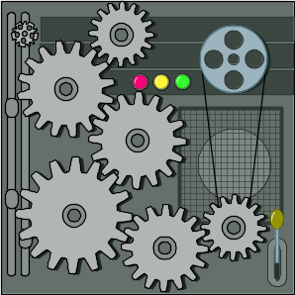
Analysis of DFS
Setting/getting a vertex/edge label takes O(1) time
Each vertex is labeled twice
  once as UNEXPLORED
  once as VISITED
Each edge is labeled twice
  once as UNEXPLORED
  once as DISCOVERY or BACK
Method incidentEdges is called once for each vertex
DFS runs in O(n + m) time provided the graph is represented by the adjacency list structure
  Recall that Σ_{v} deg(v) = 2m

Slide 28
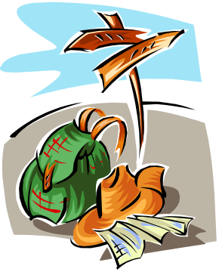
Path Finding
We can specialize the DFS algorithm to find a path between two given vertices v and z using the template method pattern
We call DFS(G, v) with v as the start vertex
We use a stack S to keep track of the path between the start vertex and the current vertex
As soon as destination vertex z is encountered, we return the path as the contents of the stack
Algorithm pathDFS(G, v, z)
{ setLabel(v, VISITED);
S.push(v);
  if ( v = z )
  return S.elements();
  for all e ∈ G.incidentEdges(v)
  if ( getLabel(e) = UNEXPLORED )
  { w = opposite(v,e);
  if ( getLabel(w) = UNEXPLORED )
  { setLabel(e, DISCOVERY);
  S.push(e);
  pathDFS(G, w, z);
  S.pop(e);
  }
  else
  setLabel(e, BACK);
  }
  S.pop(v);
  }

Slide 29

Cycle Finding
We can specialize the DFS algorithm to find a simple cycle using the template method pattern
We use a stack S to keep track of the path between the start vertex and the current vertex
As soon as a back edge (v, w) is encountered, we return the cycle as the portion of the stack from the top to vertex w
Algorithm cycleDFS(G, v, z)
{ setLabel(v, VISITED);
S.push(v);
  for all e ∈ G.incidentEdges(v)
  if ( getLabel(e) = UNEXPLORED )
  { w = opposite(v,e);
  S.push(e);
  if ( getLabel(w) = UNEXPLORED )
  { setLabel(e, DISCOVERY);
  pathDFS(G, w, z);
  S.pop(e); }
  else
  { T = new empty stack
  repeat
  { o = S.pop();
  T.push(o); }
  until ( o = w );
  return T.elements(); }
  S.pop(v);
  }

Slide 30
Breadth-First Search
L₀
A
L₁
B
C
D
L₂
E
F

Slide 31
Breadth-First Search
Breadth-first search (BFS) is a general technique for traversing a graph
A BFS traversal of a graph G
  Visits all the vertices and edges of G
  Determines whether G is connected
  Computes the connected components of G
  Computes a spanning forest of G
BFS on a graph with n vertices and m edges takes O(n + m ) time
BFS can be further extended to solve other graph problems
  Find and report a path with the minimum number of edges between two given vertices
  Find a simple cycle, if there is one

Slide 32
BFS Algorithm
The algorithm uses a mechanism for setting and getting “labels” of vertices and edges
Algorithm BFS(G, s)
{ L₀ = new empty sequence;
  L₀.insertLast(s);
  setLabel(s, VISITED);
  i = 0;
  while ( ¬L_{i}.isEmpty() )
  { L_{i +1} = new empty sequence;
  for all v ∈ L_{i}.elements()
  for all e ∈ G.incidentEdges(v)
  if ( getLabel(e) = UNEXPLORED )
  { w = opposite(v,e);
  if ( getLabel(w) = UNEXPLORED )
  { setLabel(e, DISCOVERY);
  setLabel(w, VISITED);
  L_{i +1}.insertLast(w); }
  else
  setLabel(e, CROSS);
  }
  i = i +1;
  }
  }
Algorithm BFS(G)
Input graph G
Output labeling of the edges
and partition of the
vertices of G
{
for all u ∈ G.vertices()
setLabel(u, UNEXPLORED);
for all e ∈ G.edges()
setLabel(e, UNEXPLORED);
for all v ∈ G.vertices()
if ( getLabel(v) = UNEXPLORED )
BFS(G, v);
}

Slide 33
Example (1/3)
L₀
unexplored vertex
A
A
A
visited vertex
L₁
B
C
D
unexplored edge
discovery edge
E
F
cross edge
L₀
L₀
A
A
L₁
L₁
B
C
D
B
C
D
E
F
E
F

Slide 34
Example (2/3)
L₀
L₀
A
A
L₁
L₁
B
C
D
B
C
D
L₂
E
F
E
F
L₀
L₀
A
A
L₁
L₁
B
C
D
B
C
D
L₂
L₂
E
F
E
F

Slide 35
Example (3/3)
L₀
L₀
A
A
L₁
L₁
B
C
D
B
C
D
L₂
L₂
E
F
E
F
L₀
A
L₁
B
C
D
L₂
E
F

Slide 36
Properties
Notation
  G_{s}: connected component of s
Property 1
BFS(G, s) visits all the vertices and edges of G_{s}
Property 2
The discovery edges labeled by BFS(G, s) form a spanning tree T_{s} of G_{s}
Property 3
For each vertex v in L_{i}
  The path of T_{s} from s to v has i edges
  Every path from s to v in G_{s} has at least i edges
A
B
C
D
E
F
L₀
A
L₁
B
C
D
L₂
E
F

Slide 37
Analysis
Setting/getting a vertex/edge label takes O(1) time
Each vertex is labeled twice
  once as UNEXPLORED
  once as VISITED
Each edge is labeled twice
  once as UNEXPLORED
  once as DISCOVERY or CROSS
Each vertex is inserted once into a sequence L_{i}
Method incidentEdges is called once for each vertex
BFS runs in O(n + m) time provided the graph is represented by the adjacency list structure
  Recall that Σ_{v} deg(v) = 2m

Slide 38
Applications
Using the template method pattern, we can specialize the BFS traversal of a graph G to solve the following problems in O(n + m) time
  Compute the connected components of G
  Compute a spanning forest of G
  Find a simple cycle in G, or report that G is a forest
  Given two vertices of G, find a path in G between them with the minimum number of edges, or report that no such path exists

Slide 39
DFS vs. BFS (1/2)
Applications | DFS | BFS
Spanning forest, connected components, paths, cycles | √ | √
Shortest paths |  | √
Biconnected components | √
L₀
A
A
L₁
B
C
D
B
C
D
L₂
E
F
E
F
DFS
BFS

Slide 40
DFS vs. BFS (2/2)
Back edge (v,w)
  w is an ancestor of v in the tree of discovery edges
Cross edge (v,w)
  w is in the same level as v or in the next level in the tree of discovery edges
L₀
A
A
L₁
B
C
D
B
C
D
L₂
E
F
E
F
DFS
BFS

Slide 41
Directed Graphs
BOS
ORD
JFK
SFO
DFW
LAX
MIA

Slide 42
Digraphs
A digraph is a graph whose edges are all directed
  Short for “directed graph”
Applications
  one-way streets
  flights
  task scheduling
E
D
C
B
A

Slide 43
Digraph Properties
E
D
C
B
A graph G=(V,E) such that
  Each edge goes in one direction:
    Edge (a,b) goes from a to b, but not b to a.
If G is simple, m < n*(n-1).
If we keep in-edges and out-edges in separate adjacency lists, we can perform listing of in-edges and out-edges in time proportional to their size.
A

Slide 44
Digraph Application
Scheduling: edge (a,b) means task a must be completed before b can be started
ics21
ics22
ics23
ics51
ics53
ics52
ics161
ics131
ics141
ics121
ics171
The good life
ics151

Slide 45
Directed DFS
We can specialize the traversal algorithms (DFS and BFS) to digraphs by traversing edges only along their direction
In the directed DFS algorithm, we have four types of edges
  discovery edges
  back edges
  forward edges
  cross edges
A directed DFS starting a a vertex s determines the vertices reachable from s
E
D
C
B
A

Slide 46

Reachability
DFS tree rooted at v: vertices reachable from v via directed paths
E
D
E
D
C
A
C
F
E
D
A
B
C
F
A
B

Slide 47
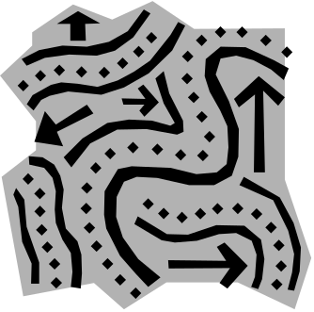
Strong Connectivity
Each vertex can reach all other vertices
a
g
c
d
e
b
f

Slide 48
Strong Connectivity Algorithm
Pick a vertex v in G.
Perform a DFS from v in G.
  If there’s a w not visited, print “no”.
Let G’ be G with edges reversed.
Perform a DFS from v in G’.
  If there’s a w not visited, print “no”.
  Else, print “yes”.
Running time: O(n+m).
G:
a
c
g
d
e
f
b
a
G’:
c
g
d
e
f
b

Slide 49

Strongly Connected Components
Maximal subgraphs such that each vertex can reach all other vertices in the subgraph
Can also be done in O(n+m) time using DFS, but is more complicated (similar to biconnectivity).
a
g
{ a , c , g }
c
d
e
{ f , d , e , b }
f
b

Slide 50
Transitive Closure
Given a digraph G, the transitive closure of G is the digraph G* such that
  G* has the same vertices as G
  if G has a directed path from u to v (u ≠ v), G* has a directed edge from u to v
The transitive closure provides reachability information about a digraph
D
E
B
G
C
A
D
E
B
C
A
G*

Slide 51

Computing the Transitive Closure
If there's a way to get from A to B and from B to C, then there's a way to get from A to C.
We can perform DFS starting at each vertex
  O(n(n+m))
Alternatively ... Use dynamic programming: The Floyd-Warshall Algorithm

Slide 52
Floyd-Warshall Transitive Closure
Idea #1: Number the vertices 1, 2, …, n.
Idea #2: Consider paths that use only vertices numbered 1, 2, …, k, as intermediate vertices:
Uses only vertices numbered 1,…,k
(add this edge if it’s not already in)
i
j
Uses only vertices
numbered 1,…,k-1
Uses only vertices
numbered 1,…,k-1
k

Slide 53
Floyd-Warshall’s Algorithm
Floyd-Warshall’s algorithm numbers the vertices of G as v₁ , …, v_{n} and computes a series of digraphs G₀, …, G_{n}
  G₀=G
  G_{k} has a directed edge (v_{i}, v_{j}) if G has a directed path from v_{i} to v_{j} with intermediate vertices in the set {v₁ , …, v_{k}}
We have that G_{n} = G*
In phase k, digraph G_{k} is computed from G_{k − 1}
Running time: O(n³), assuming areAdjacent is O(1) (e.g., adjacency matrix)
Algorithm FloydWarshall(G)
Input digraph G
Output transitive closure G* of G
{ i = 1;
for all v ∈ G.vertices()
{ denote v as v_{i} ;
i = i + 1; }
G₀ = G;
for k = 1 to n do
{ G_{k} = G_{k -1};
for i = 1 to n (i ≠ k) do
for j = 1 to n (j ≠ i, k) do
if G_{k − 1}.areAdjacent(v_{i}, v_{k}) ∧
G_{k − 1}.areAdjacent(v_{k}, v_{j})
if ¬G_{k}.areAdjacent(v_{i}, v_{j})
G_{k}.insertDirectedEdge(v_{i}, v_{j} , k);
}
return G_{n}
}

Slide 54

Floyd-Warshall Example
BOS
ORD
v
4
JFK
v
2
v
6
SFO
DFW
LAX
v
v
3
1
MIA
v
5

Slide 55
Floyd-Warshall, Iteration 1
BOS
ORD
v
4
JFK
v
2
v
6
SFO
DFW
LAX
v
v
3
1
MIA
v
5

Slide 56
Floyd-Warshall, Iteration 2
BOS
ORD
v
4
JFK
v
2
v
6
SFO
DFW
LAX
v
v
3
1
MIA
v
5

Slide 57
Floyd-Warshall, Iteration 3
BOS
ORD
v
4
JFK
v
2
v
6
SFO
DFW
LAX
v
v
3
1
MIA
v
5

Slide 58
Floyd-Warshall, Iteration 4
BOS
ORD
v
4
JFK
v
2
v
6
SFO
DFW
LAX
v
v
3
1
MIA
v
5

Slide 59
Floyd-Warshall, Iteration 5
BOS
ORD
v
4
JFK
v
2
v
6
SFO
DFW
LAX
v
v
3
1
MIA
v
5

Slide 60
Floyd-Warshall, Iteration 6
BOS
ORD
v
4
JFK
v
2
v
6
SFO
DFW
LAX
v
v
3
1
MIA
v
5

Slide 61
Floyd-Warshall, Conclusion
BOS
ORD
v
4
JFK
v
2
v
6
SFO
DFW
LAX
v
v
3
1
MIA
v
5

Slide 62
DAGs and Topological Ordering
D
E
A directed acyclic graph (DAG) is a digraph that has no directed cycles
A topological ordering of a digraph is a numbering
v₁ , …, v_{n}
of the vertices such that for every edge (v_{i} , v_{j}), we have i < j
Example: in a task scheduling digraph, a topological ordering a task sequence that satisfies the precedence constraints
Theorem
A digraph admits a topological ordering if and only if it is a DAG
B
C
A
DAG G
v₄
v₅
D
E
v₂
B
v₃
v₁
C
Topological ordering of G
A

Slide 63

Topological Sorting
Number vertices, so that (u,v) in E implies u < v
wake up
1
A typical student day
2
3
eat
study computer sci.
4
5
nap
more c.s.
7
play
8
write c.s. program
6
9
work out
make cookies for professors
10
sleep
11
dream about graphs

Slide 64
Algorithm for Topological Sorting
Note: This algorithm is different than the one in Goodrich-Tamassia
Running time: O(n + m). How…?
Method TopologicalSort(G)
{ H = G; // Temporary copy of G
n = G.numVertices();
while H is not empty do
{ Let v be a vertex with no outgoing edges;
Label v = n;
n = n – 1;
Remove v from H;
}
}

Slide 65
Topological Sorting Algorithm using DFS
Simulate the algorithm by using depth-first search
O(n+m) time.
Algorithm topologicalDFS(G, v)
Input graph G and a start vertex v of G
Output labeling of the vertices of G
in the connected component of v
{ setLabel(v, VISITED);
for all e ∈ G.incidentEdges(v)
if ( getLabel(e) = UNEXPLORED )
{ w = opposite(v,e);
if ( getLabel(w) = UNEXPLORED )
{ setLabel(e, DISCOVERY);
topologicalDFS(G, w); }
}
Label v with topological number n;
n = n – 1;
return;
}
Algorithm topologicalDFS(G)
Input dag G
Output topological ordering of G
{ n = G.numVertices();
for all u ∈ G.vertices()
setLabel(u, UNEXPLORED);
for all e ∈ G.edges()
setLabel(e, UNEXPLORED);
for all v ∈ G.vertices()
if ( getLabel(v) = UNEXPLORED )
topologicalDFS(G, v);
}

Slide 66
Topological Sorting Example (1/10)

Slide 67
Topological Sorting Example (2/10)
9

Slide 68
Topological Sorting Example (3/10)
8
9

Slide 69
Topological Sorting Example (4/10)
7
8
9

Slide 70
Topological Sorting Example (5/10)
6
7
8
9

Slide 71
Topological Sorting Example (6/10)
6
5
7
8
9

Slide 72
Topological Sorting Example (7/10)
4
6
5
7
8
9

Slide 73
Topological Sorting Example (8/10)
3
4
6
5
7
8
9

Slide 74
Topological Sorting Example (9/10)
2
3
4
6
5
7
8
9

Slide 75
Topological Sorting Example (10/10)
2
1
3
4
6
5
7
8
9

Slide 76
References
Chapter 13, Data Structures and Algorithms by Goodrich and Tamassia.

